Slide 1


Dr. Kalpana Ambepitiya

Slide 2

Assessing a New Venture’s Financial Strength and Viability
8-<number>

Slide 3
Financial Management
1 of 2
Financial Management
  Financial management deals with two things: raising money and managing a company’s finances in a way that achieves the highest rate of return
  This chapter focuses primarily on:
    How a new venture tracks its financial progress through preparing, analyzing, and maintaining past financial statements.
8-<number>

Slide 4
Financial Management
2 of 2
The financial management of a firm deals with questions such as the following on an ongoing basis:
How are we doing? Are we making or losing money?
How much cash do we have on hand?
Do we have enough cash to meet our short-term obligations?
How efficiently are we utilizing our assets?
How does our growth and net profits compare to those of our industry peers?
Where will the funds we need for capital improvements come from?
Are there ways we can partner with other firms to share risk and reduce the
amount of cash we need?
Overall, are we in good shape financially?
8-<number>

Slide 5
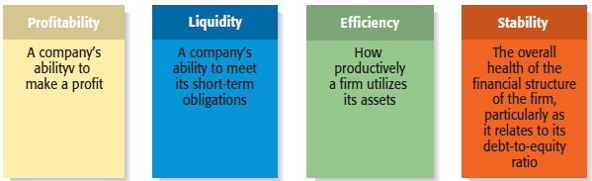
Financial Objectives of a Firm
1 of 3
8-<number>

Slide 6
Financial Objectives of a Firm
2 of 3
Profitability
  Is the ability to earn a profit.
    Many start-ups are not profitable during their first one to three years while they are training employees and building their brands.
    However, a firm must become profitable to remain viable and provide a return to its owners.
Liquidity
  Is a company’s ability to meet its short-term financial obligations.
    Even if a firm is profitable, it is often a challenge to keep enough money in the bank to meet its routine obligations in a timely manner.
8-<number>

Slide 7
Financial Objectives of a Firm
3 of 3
Efficiency
  Is how productively a firm utilizes its assets relative to its revenue and its profits.
    Southwest Airlines, for example, uses its assets very productively. Its turnaround time, or the time its airplanes sit on the ground while they are being unloaded and reloaded, is the lowest in the airline industry.
Stability
  Is the strength and vigor of the firm’s overall financial posture.
    For a firm to be stable, it must not only earn a profit and remain liquid but also keep its debt in check.
8-<number>

Slide 8
The Process of Financial Management
1 of 4
Importance of Financial Statements
  To assess whether its financial objectives are being met, firms rely heavily on analysis of financial statements.
    A financial statement is a written report that quantitatively describes a firm’s financial health.
    The income statement, the balance sheet, and the statement of cash flows are the financial statements entrepreneurs use most commonly.
Forecasts
  Are an estimate of a firm’s future income and expenses, based on past performance, its current circumstances, and its future plans.
8-<number>

Slide 9
The Process of Financial Management
2 of 4
Forecasts (continued)
  New ventures typically base their forecasts on an estimate of sales and then on industry averages or the experiences of similar start-ups regarding the cost of goods sold and other expenses.
Budgets
  Are itemized forecasts of a company’s income, expenses, and capital needs and are also an important tool for financial planning and control.
8-<number>

Slide 10
The Process of Financial Management
3 of 4
Financial Ratios
  Depict relationships between items on a firm’s financial statements.
  An analysis of its financial ratios helps a firm determine whether it is meeting its financial objectives and how it stakes up against industry peers.
Importance of Financial Management
  Many experienced entrepreneurs stress the importance of keeping on top of the financial management of the firm.
8-<number>

Slide 11
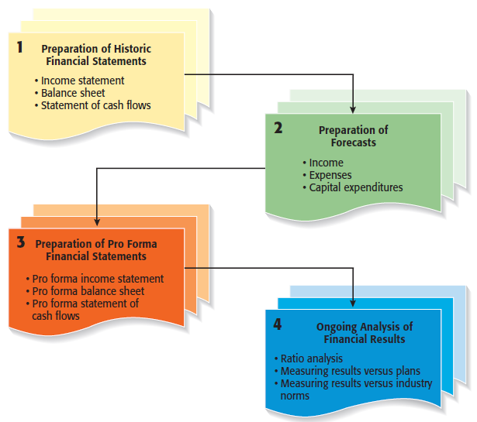
The Process of Financial Management
4 of 4
8-<number>

Slide 12
All rights reserved. No part of this publication may be reproduced, stored in a retrieval system, or transmitted, in any form or by any means, electronic, mechanical, photocopying, recording, or otherwise, without the prior written permission of the publisher. Printed in the United States of America.
Copyright ©2010 Pearson Education, Inc.

